Slide 1

On Becoming a Leader in Risk Management
Fundamentals of RM
RM System and Process
Leadership in RM
Incident Investigation
RM tools & Challenges
RM in Industry
People & Org.
Application and Perspectives
ENGG404 - Lecture
Chapter 4.1: Incident Investigation, Root Cause Analysis, and Managing Corrective Actions
Tee-up the Sherlock Holmes Video: Show in the few moments prior to the start of the lecture. Link:
https://drive.google.com/open?id=1D4dAsd1oo_rL5D_1ktDUy0tFwVmPkKyg
1
Notes:
1

Slide 2
Learning Outcomes:
Explain the need to investigate the scene and collect evidence.
Explain and apply the general work process to lead an Incident Investigation immediately after an incident happens, through the RCA and MCA work processes, and to conclude with a final check on the effectiveness of the process.
Chapter 4.1: II-RCA-MCA Work Processes
2
Notes:
2

Slide 3
Introduction:
Incidents do happen. If the causes leading to an incident are not addressed, the incident can potentially repeat itself.
Most organizations have systems in place for incident investigation and follow-up.
This lecture presents a framework for the overall work process for Incident Investigation (II), analysis and to propose corrective measures.
Tools for analysis that we will see in the following lectures include Root Cause Analysis (RCA), Cause and Effect Models (C&E), and Manage Corrective Actions (MCA).
Chapter 4.1: II-RCA-MCA Work Processes
3
Notes:
3

Slide 4
Overall II-RCA-MA Work Process (general workflow):
Incident Happens
Incident Investigation: collect evidence relating to an event (i.e. the discovery and ascertainment of the facts of a loss incident).
Incident Investigation
Root Cause Analysis (RCA): determine the causes of an incident (Chapter 4.3).
Root Cause Analysis
Manage Corrective Actions
Manage Corrective Actions: manages the corrective and preventative actions that address the latent causes identified in the RCA (Chapter 4.5 and 4.6)
Check Process Effectiveness
Chapter 4.1: II-RCA-MCA Work Processes
4
Notes:
4

Slide 5
Detailed II-RCA-MA Work Process (typical):
Incident Happens
Conduct the
Root Cause Analysis
Appraise situation
Reach conclusions
Stop
Investigate?
no
Make Recommendations
yes
Start collecting evidence
Report and Communicate
Pick Team
Follow-up to a conclusion
Continue collecting evidence
Check effectiveness of the Investigation Process
no
yes
All details known?
Chapter 4.1: II-RCA-MCA Work Processes
5
Notes:
5

Slide 6
Incidents Investigated, or Managed Using this Work Process:
When should you investigate an incident?
Most likely not all incidents can be investigated and managed, so how do you choose which incidents to investigate?
Investigations require resources.
Need to define “threshold criteria” in order to assign and use resources effectively!
Challenges:
Some organizations: may do nothing except the bare minimum as may be required by law.
Others have explicit criteria as to what requires an investigation.
Can only investigate when an incident is reported – strong culture that encourages reporting
Chapter 4.1: II-RCA-MCA Work Processes
6
Notes:
6

Slide 7
Who Undertakes the Overall II-RCA-MCA Work Process?
Impartial leader, familiar with the processes, has credibility.
Investigation Team composition (not involved in the incident):
One or more experts in the incident investigation process and the root cause analysis process
One or more technical experts or specialists familiar with the work process being undertaken
Chapter 4.1: II-RCA-MCA Work Processes
7
Notes:
7

Slide 8

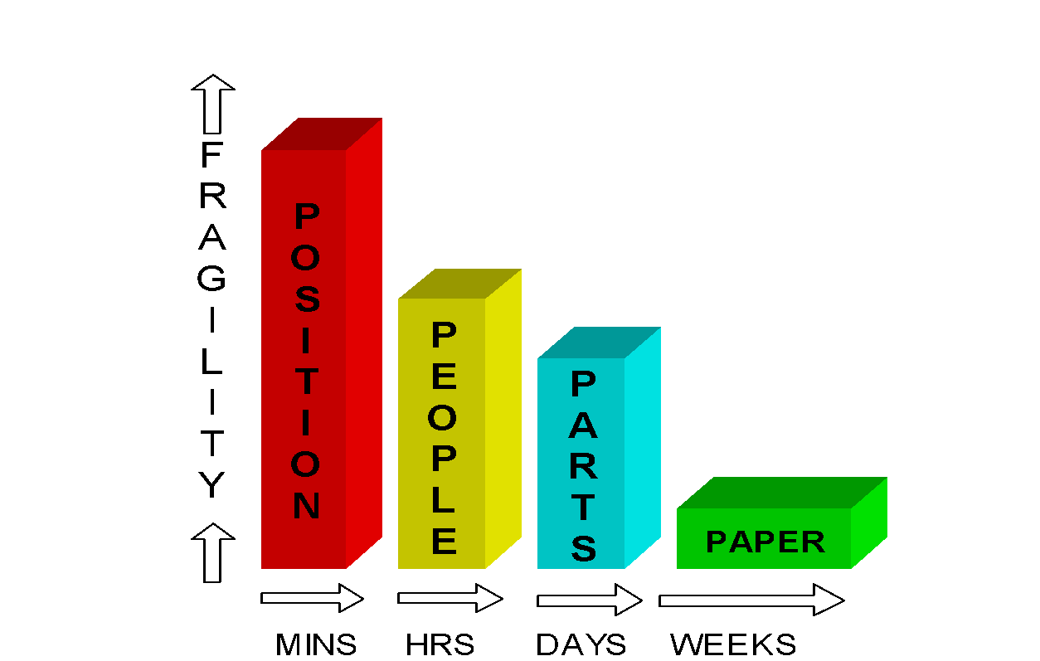
Evidence – You Need to Know What Happened and How:
When gathering evidence, time is most important!
Evidence can reveal what happened and how, but evidence can deteriorate with time.
Preservation of evidence:
Chapter 4.1: II-RCA-MCA Work Processes
8
Notes:
8

Slide 9
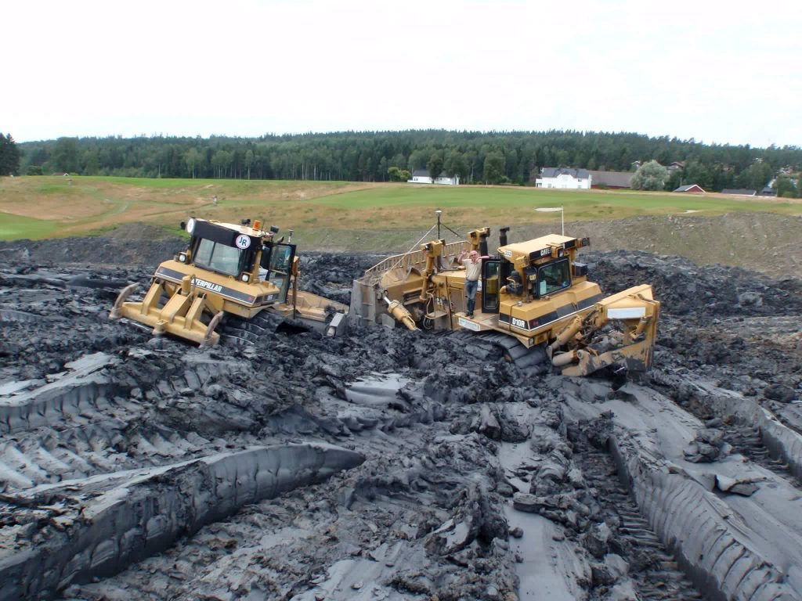
Example: The Caterpillar D12 Dozer Loss Incident
A Cat D12 dozer has gotten stuck in unexpected soft and wet clay.
The operator is all right, but the dozer requires repairs (down time).
A broken water pipe was found adjacent to the dozer. The dozer was within its planned route and the area had just been regraded.
Chapter 4.1: II-RCA-MCA Work Processes
9
Notes:
9

Slide 10
Summary:
These processes will be effective only if all components are complete, accurate, and thorough.
Process is a learning experience for all.
Must commit to the process with people and resources for investigations.
Chapter 4.1: II-RCA-MCA Work Processes
10
Notes:
10

